Slide 1
Chapter 4: Network Access
Introduction to Networks
Notes:
Cisco Networking Academy program
Introduction to Networks
Chapter 4: Network Access

Slide 2
Chapter 4: Objectives
Students will be able to:
Explain how physical layer protocols and services support communications across data networks.
Build a simple network using the appropriate.
Explain the role of the data link layer in supporting communications across data networks.
Compare media access control techniques and logical topologies used in networks.
Notes:
2

Slide 3
Chapter 4
4.1 Physical Layer Protocols
4.2 Network Media
4.3 Data Link Layer Protocols
4.4 Media Access Control
4.5 Summary
Notes:
Chapter 4 Sections

Slide 4
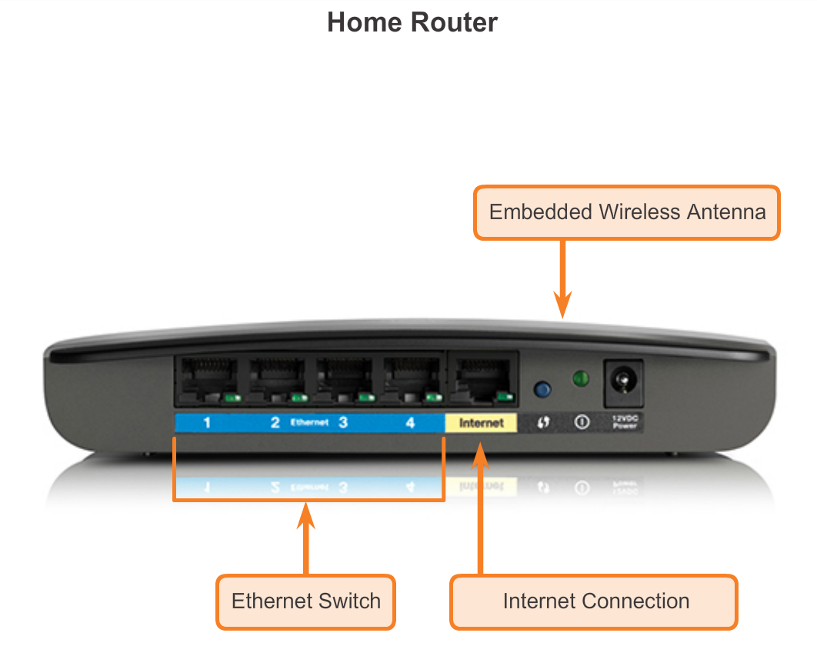
Getting it Connected Connecting to the Network
Notes:
Section 4.1.1.1

Slide 5
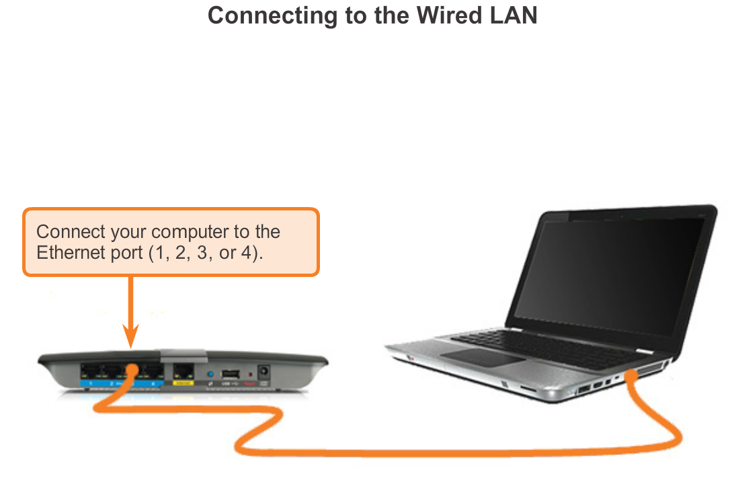
Getting it Connected Connecting to the Network
Notes:
Section 4.1.1.1

Slide 6
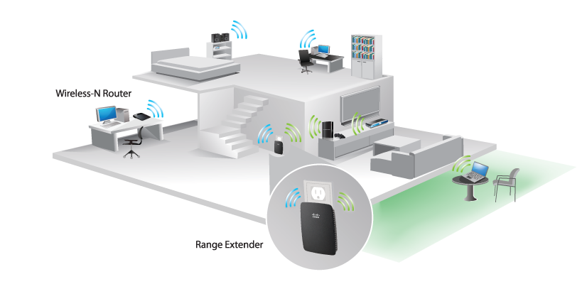
Getting it Connected Network Interface Cards
Connecting to the Wireless LAN with a Range Extender
Notes:
Section 4.1.1.2

Slide 7
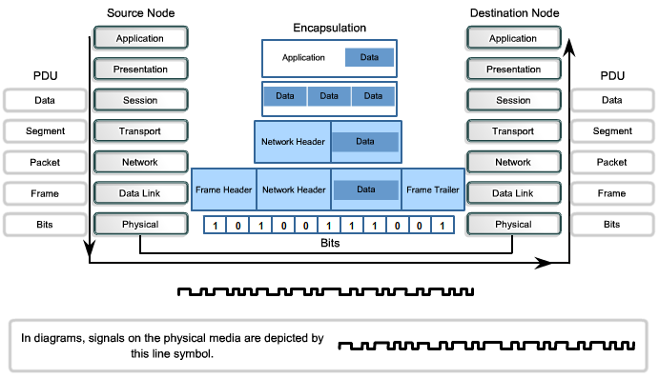
Purpose of the Physical Layer The Physical Layer
Notes:
Section 4.1.2.1

Slide 8
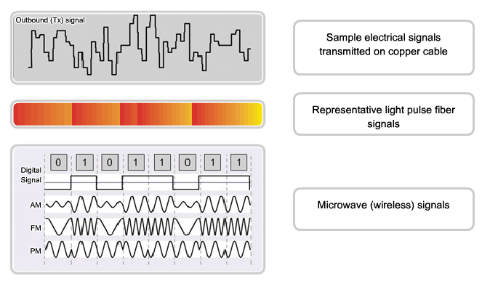
Purpose of the Physical Layer Physical Layer Media
Notes:
Section 4.1.2.2

Slide 9
Purpose of the Physical Layer Physical Layer Standards
Standard organization | Networking Standards
ISO | ISO 8877: Officially adopted the RJ connectors (e.g., RJ-11, RJ-45) ISO 11801: Network cabling standard similar to EIA/TIA 568.
EIA/TIA | TIA-568-C: Telecommunications cabling standards, used by nearly all voice, video and data networks. TIA-569-B: Commercial Building Standards for Telecommunications Pathways and Spaces TIA-598-C: Fiber optic color coding TIA-942: Telecommunications Infrastructure Standard for Data Centers
ANSI | 568-C: RJ-45 pinouts. Co-developed with EIA/TIA
ITU-T | G.992: ADSL
IEEE | 802.3: Ethernet 802.11: Wireless LAN (WLAN) & Mesh (Wi-Fi certification) 802.15: Bluetooth
Notes:
Section 4.1.2.3

Slide 10
Fundamental Principles of Layer 1 Physical Layer Fundamental Principles
Media | Physical Components | Frame Encoding Technique | Signalling Method
Copper cable | UTP Coaxial Connectors NICs Ports Interfaces | Manchester Encoding Non-Return to Zero (NRZ) techniques 4B/5B codes are used with Multi-Level Transition Level 3 (MLT-3) signaling 8B/10B PAM5 | Changes in the electromagnetic field Intensity of the electromagnetic field Phase of the electromagnetic wave
Fiber Optic cable | Single-mode Fiber Multimode Fiber Connectors NICs Interfaces Lasers and LEDs Photoreceptors | Pulses of light Wavelength multiplexing using different colors | A pulse equals 1. No pulse is 0.
Wireless media | Access Points NICs Radio Antennae | DSSS (direct-sequence spread-spectrum) OFDM (orthogonal frequency division multiplexing) | Radio waves
Notes:
Section 4.1.3.1

Slide 11
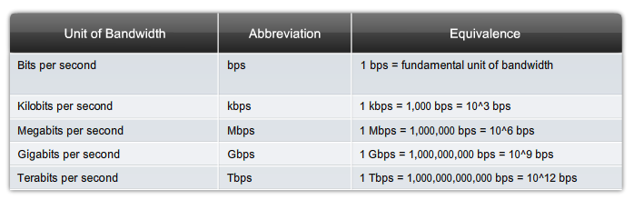
Fundamental Principles of Layer 1 Bandwidth
Notes:
Section 4.1.3.2

Slide 12
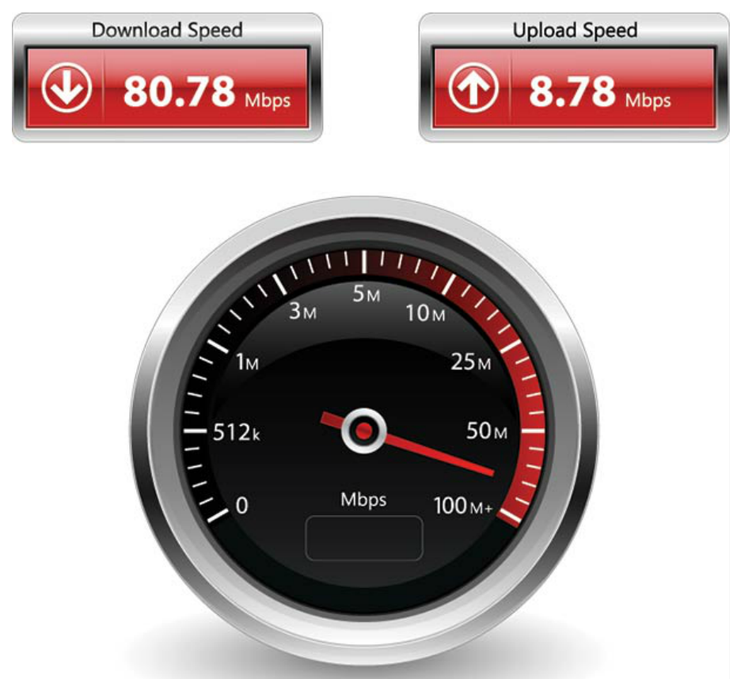
Fundamental Principles of Layer 1 Throughput
Notes:
Section 4.1.3.3

Slide 13
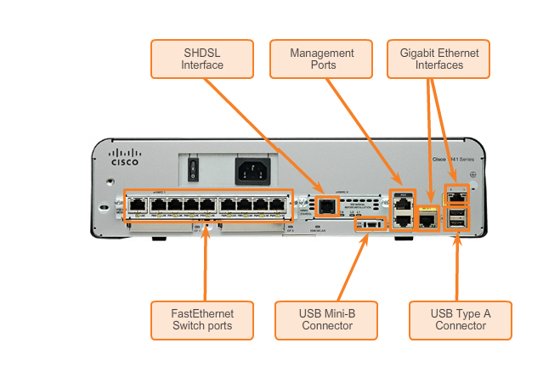
Fundamental Principles of Layer 1 Types of Physical Media
Notes:
Section 4.1.3.4

Slide 14
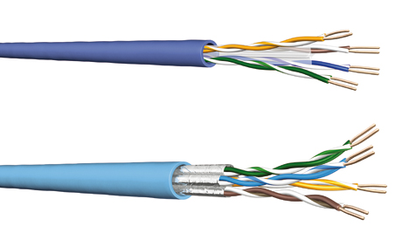
Network Media Copper Cabling
Notes:
Section 4.2.1

Slide 15
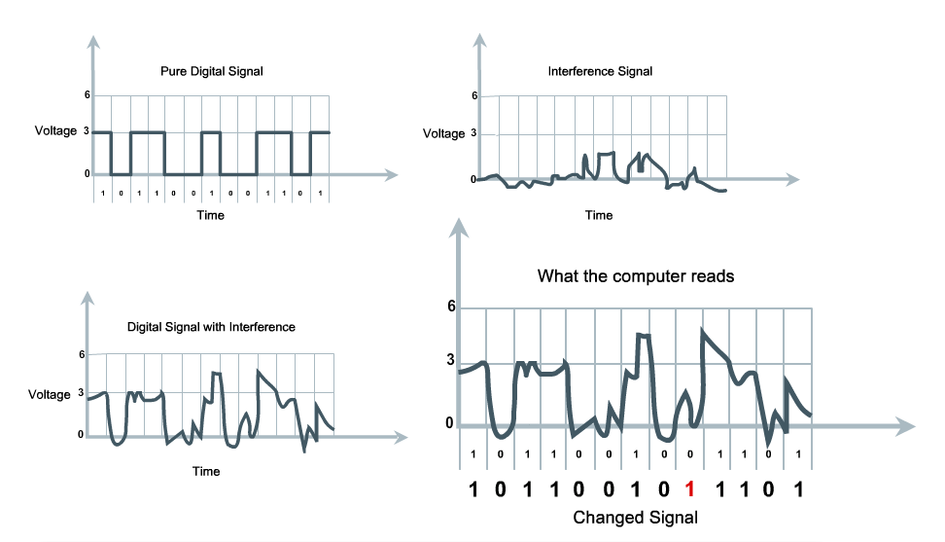
Copper Cabling Characteristics of Copper Media
Notes:
Section 4.2.1.1

Slide 16
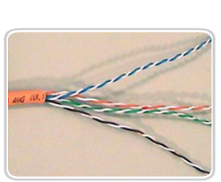
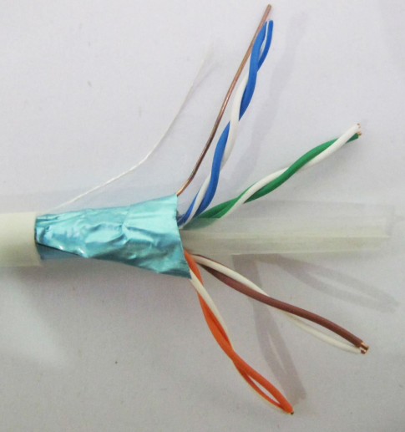

Copper Cabling Copper Media
Unshielded Twisted Pair (UTP) cable
Shielded Twisted Pair (STP) cable
Coaxial cable
Notes:
Section 4.2.1.2

Slide 17
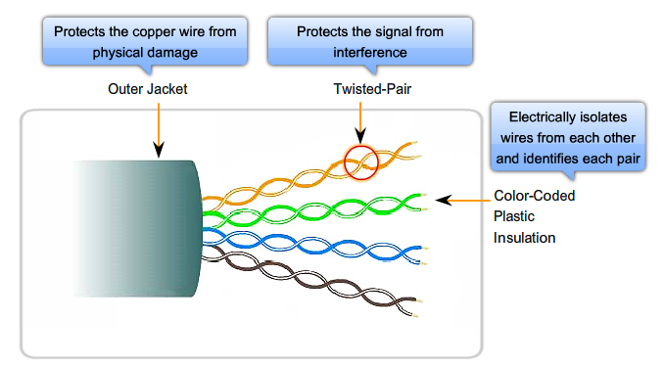
Copper Cabling Unshielded Twisted-Pair (UTP) Cable
Notes:
Section 4.2.1.3

Slide 18
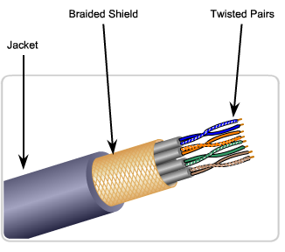
Copper Cabling Shielded Twisted-Pair (STP) Cable
Braided or Foil Shield
Foil Shields
Notes:
Section 4.2.1.4

Slide 19
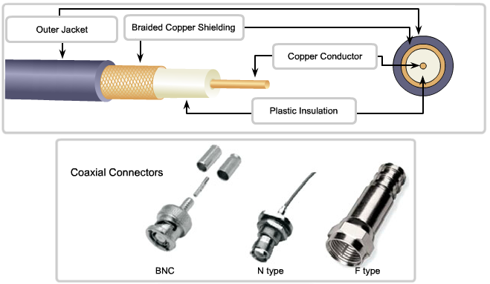
Copper Cabling Coaxial Cable
Notes:
Section 4.2.1.5

Slide 20
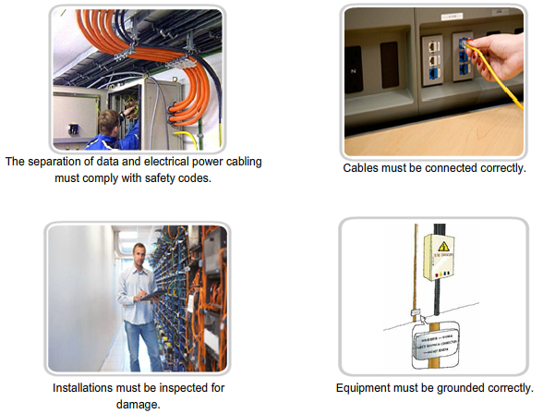
Copper Cabling Cooper Media Safety
Notes:
Section 4.2.1.6

Slide 21
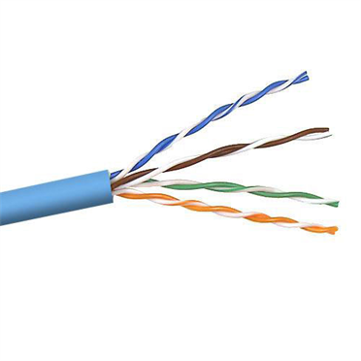
UTP Cabling Properties of UTP Cabling
Notes:
Section 4.2.2.1

Slide 22
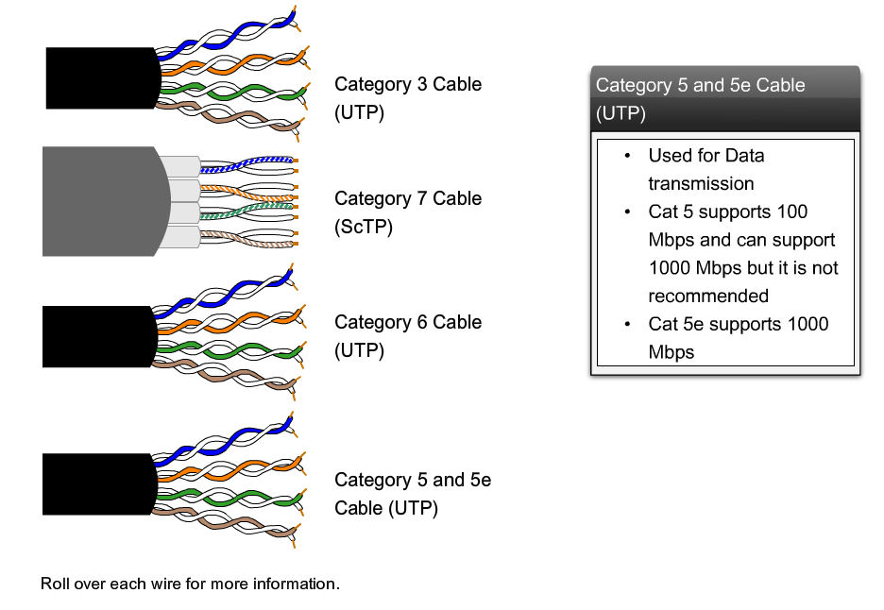
UTP Cabling UTP Cabling Standards
Notes:
Section 4.2.2.2

Slide 23
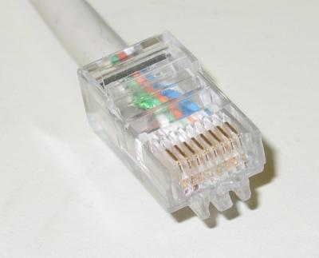
UTP Cabling UTP Connectors
Notes:
Section 4.2.2.3

Slide 24
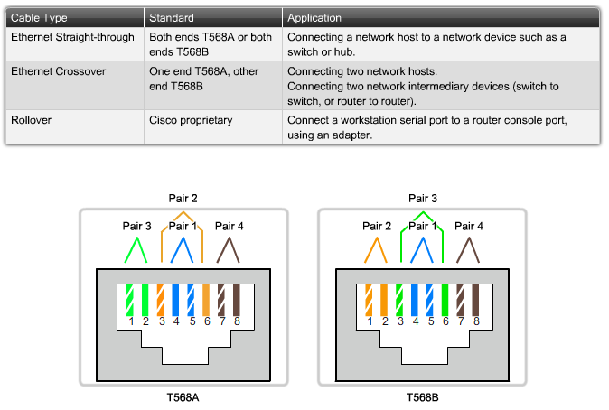
UTP Cabling Types of UTP Cable
Notes:
Section 4.2.2.4

Slide 25
UTP Cabling Testing UTP Cables
Notes:
Section 4.2.2.5

Slide 26
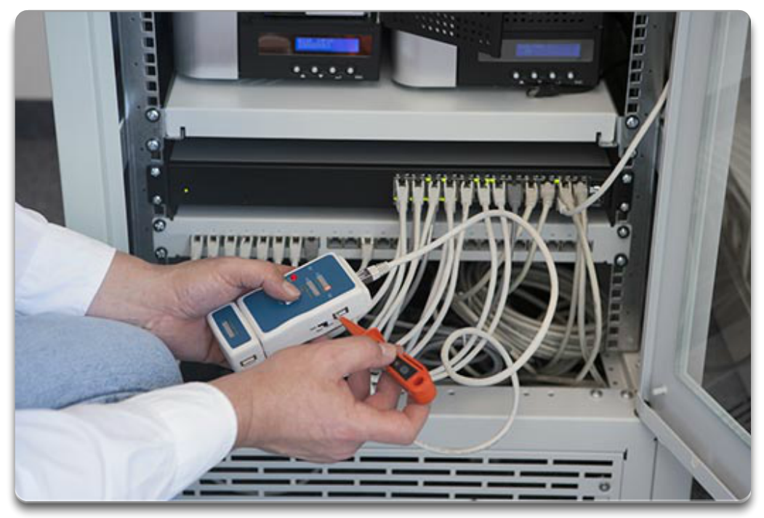
UTP Cabling Testing UTP Cables
Notes:
Section 9.4.2.6

Slide 27
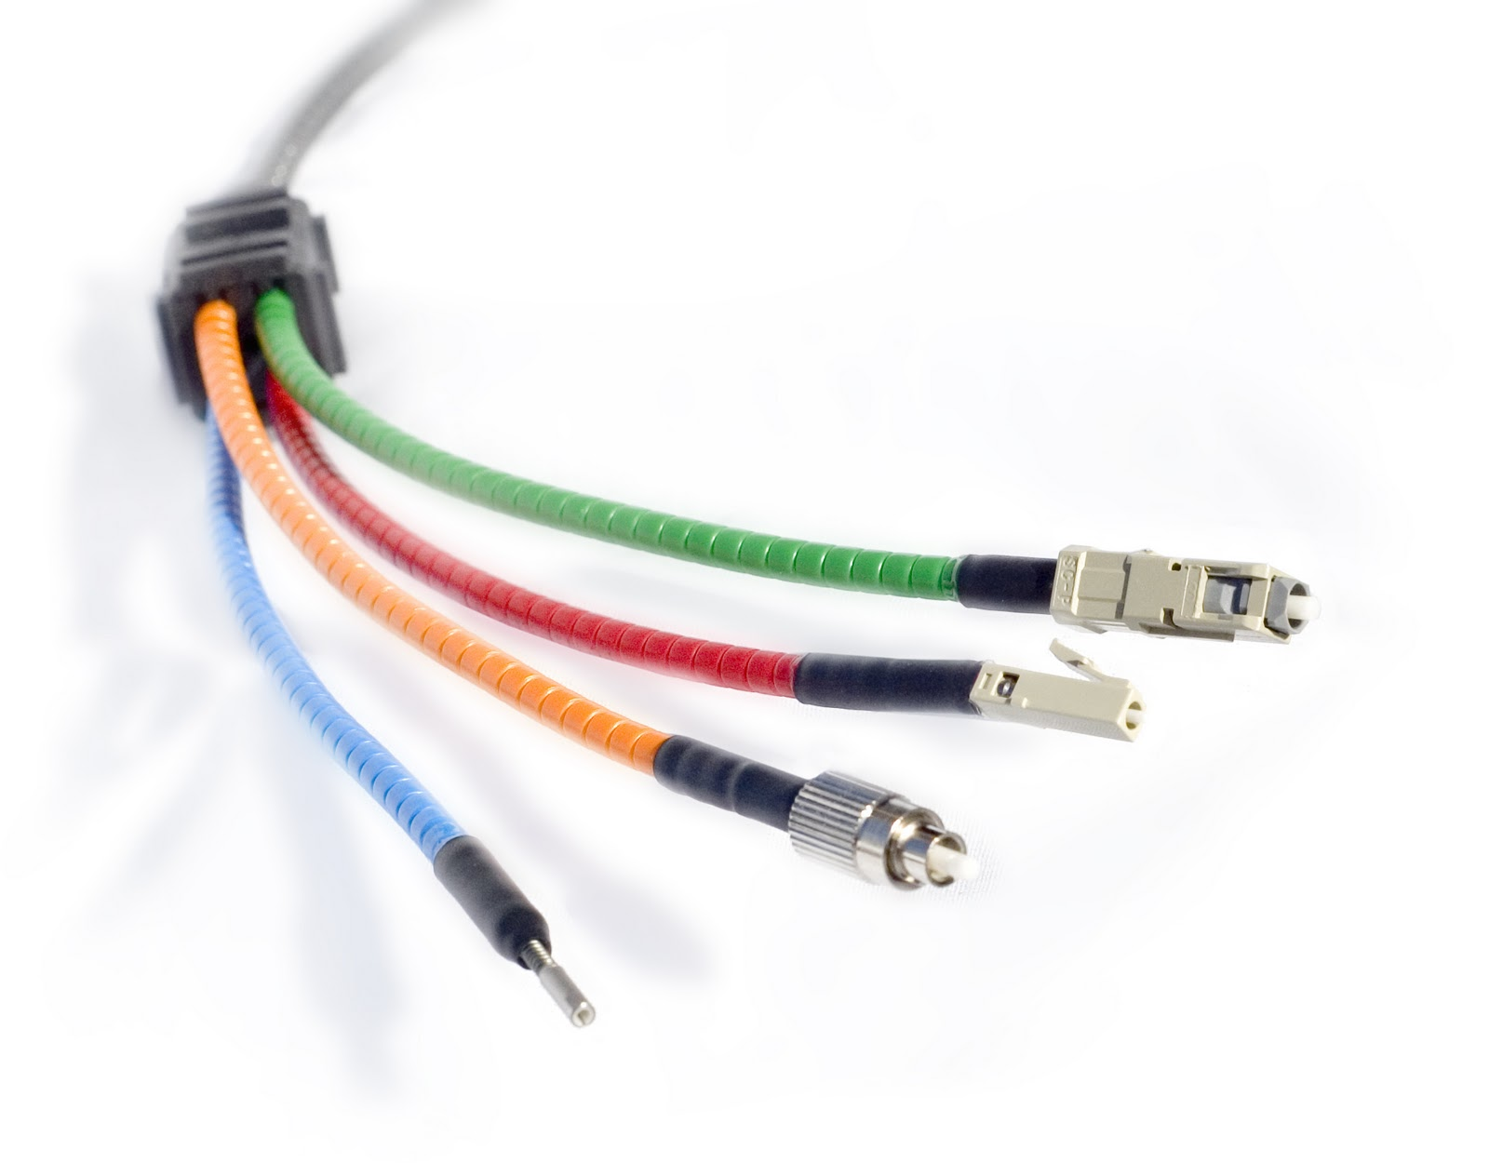
Fiber Optic Cabling Properties of Fiber Optic Cabling
Notes:
Section 4.2.3.1

Slide 28
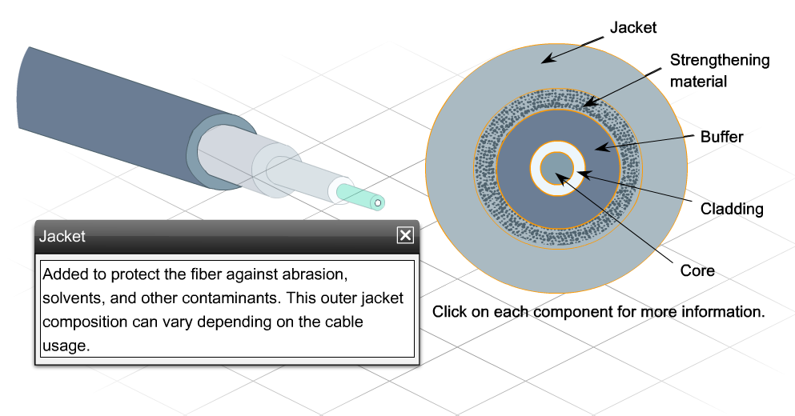
Fiber Optic Cabling Fiber Media Cable Design
Notes:
Section 4.2.3.2

Slide 29
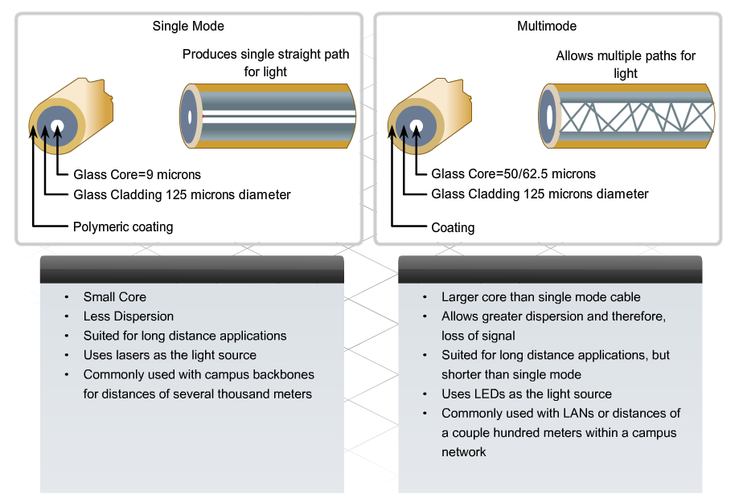
Fiber Optic Cabling Types of Fiber Media
Notes:
Section 4.2.3.3

Slide 30
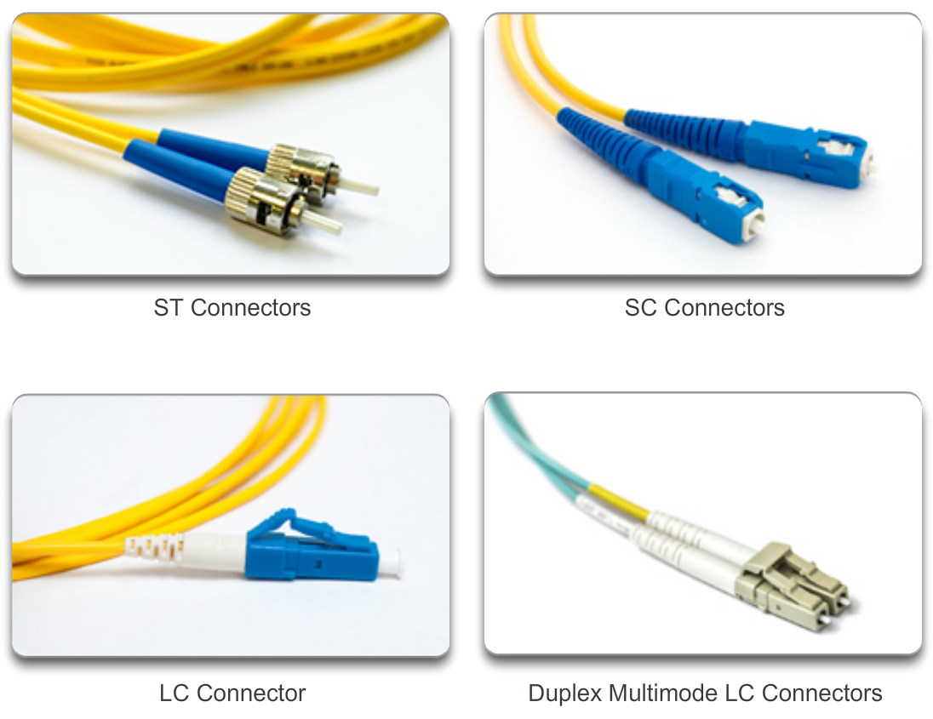
Fiber Optic Cabling Network Fiber Connectors
Notes:
Section 4.2.3.4

Slide 31
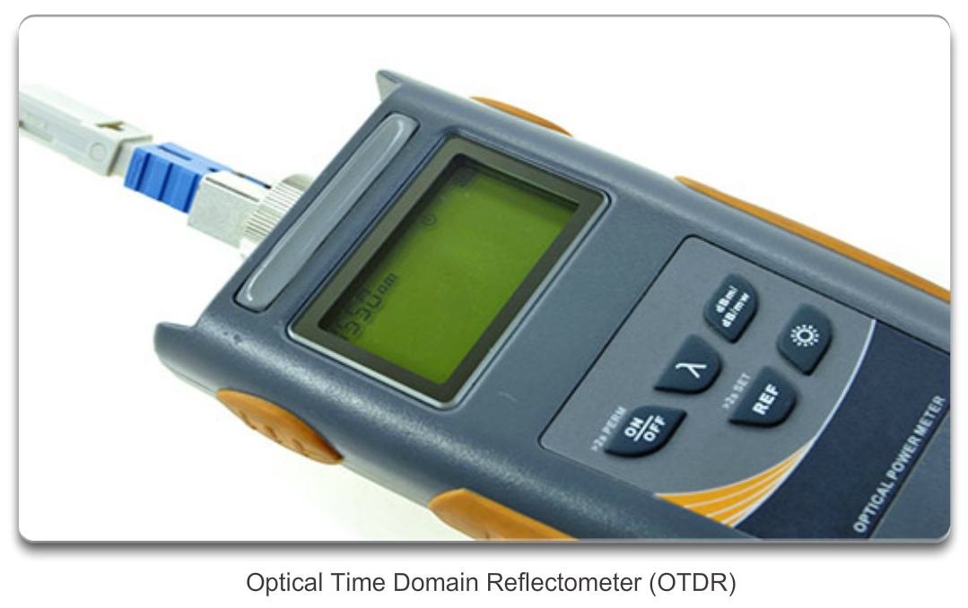
Fiber Optic Cabling Testing Fiber Cables
Notes:
Section 4.2.3.5

Slide 32
Fiber Optic Cabling Fiber versus Copper
Implementation issues | Copper media | Fibre-optic
Bandwidth supported | 10 Mbps – 10 Gbps | 10 Mbps – 100 Gbps
Distance | Relatively short (1 – 100 meters) | Relatively High (1 – 100,000 meters)
Immunity to EMI and RFI | Low | High (Completely immune)
Immunity to electrical hazards | Low | High (Completely immune)
Media and connector costs | Lowest | Highest
Installation skills required | Lowest | Highest
Safety precautions | Lowest | Highest
Notes:
Section 4.2.3.6

Slide 33
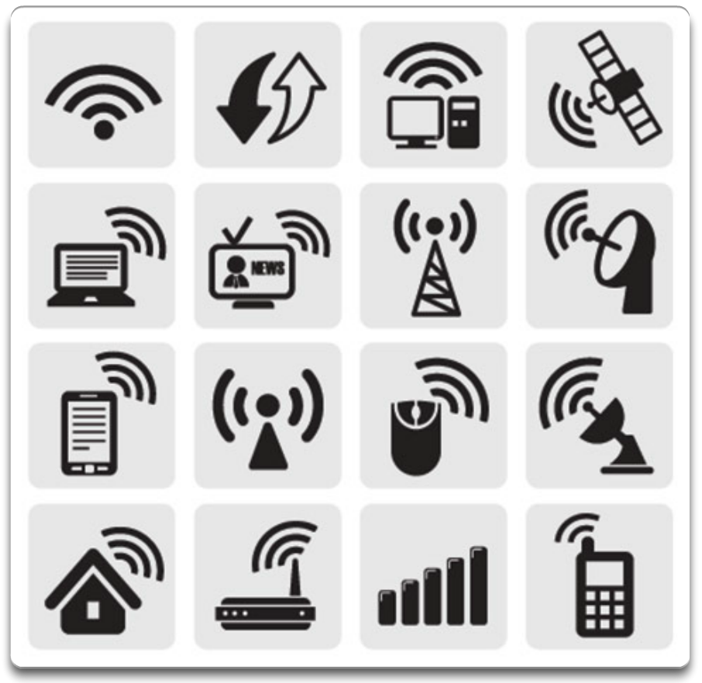
Wireless Media Properties of Wireless Media
Notes:
Section 4.2.4.1

Slide 34
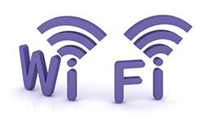


Wireless Media Types of Wireless Media
 | IEEE 802.11 standards Commonly referred to as Wi-Fi. Uses CSMA/CA Variations include: 802.11a: 54 Mbps, 5 GHz 802.11b: 11 Mbps, 2.4 GHz 802.11g: 54 Mbps, 2.4 GHz 802.11n: 600 Mbps, 2.4 and 5 GHz 802.11ac: 1 Gbps, 5 GHz 802.11ad: 7 Gbps, 2.4 GHz, 5 GHz, and 60 GHz
 | IEEE 802.15 standard Supports speeds up to 3 Mbps Provides device pairing over distances from 1 to 100 meters.
 | IEEE 802.16 standard Provides speeds up to 1 Gbps Uses a point-to-multipoint topology to provide wireless broadband access.
Notes:
Section 4.2.4.2

Slide 35
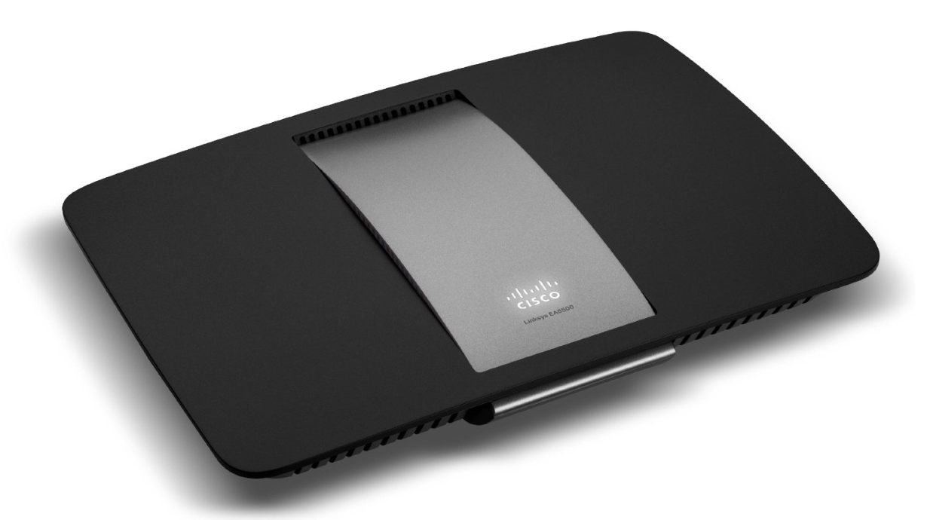
Wireless Media Wireless LAN
Cisco Linksys EA6500 802.11ac wireless router
Notes:
Section 4.2.4.3

Slide 36
Wireless Media 802.11 Wi-Fi Standards
Standard | Maximum Speed | Frequency | Backwards compatible
802.11a | 54 Mbps | 5 GHz | No
802.11b | 11 Mbps | 2.4 GHz | No
802.11g | 54 Mbps | 2.4 GHz | 802.11b
802.11n | 600 Mbps | 2.4 GHz or 5 GHz | 802.11b/g
802.11ac | 1.3 Gbps (1300 Mbps) | 2.4 GHz and 5.5 GHz | 802.11b/g/n
802.11ad | 7 Gbps (7000 Mbps) | 2.4 GHz, 5 GHz and 60 GHz | 802.11b/g/n/ac
Notes:
Section 4.2.4.4

Slide 37
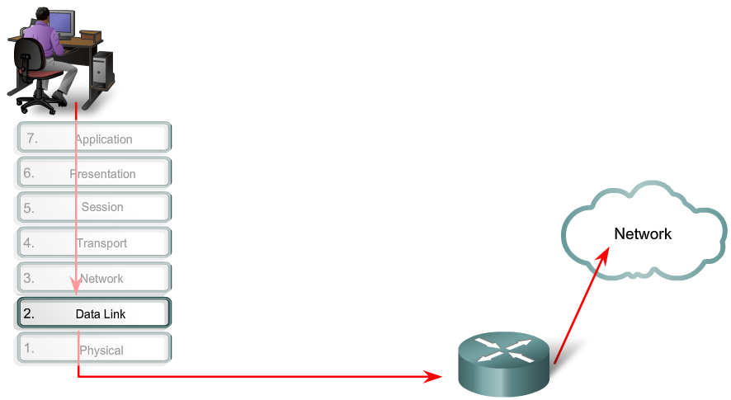
Purpose of the Data Link Layer The Data Link Layer
Notes:
Section 4.3.1.1

Slide 38
Purpose of the Data Link Layer Data Link Sublayers
Network
Data Link | LLC Sublayer
 | MAC Sublayer
Physical
802.3
Ethernet
802.11
Wi-Fi
802.15
Bluetooth
Notes:
Section 4.3.1.2

Slide 39
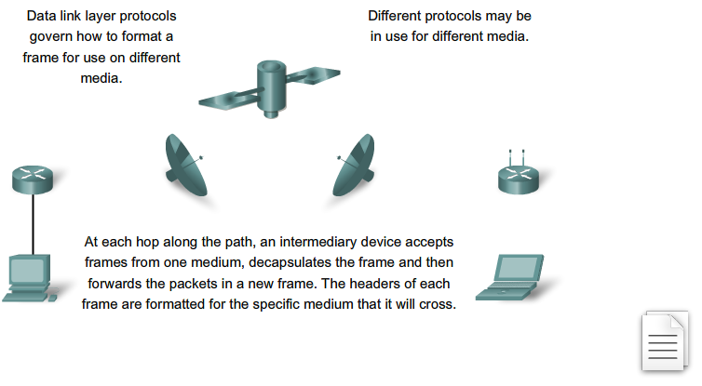
Purpose of the Data Link Layer Media Access Control
Notes:
Section 4.3.1.3

Slide 40
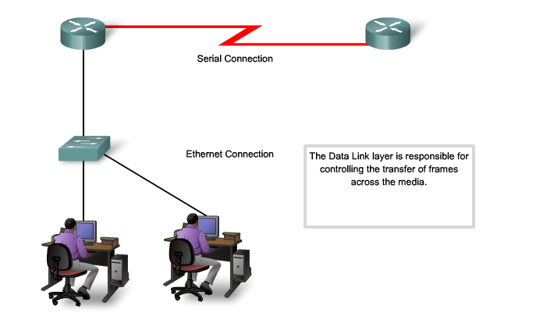
Purpose of the Data Link Layer Providing Access to Media
Notes:
Section 4.3.1.4

Slide 41
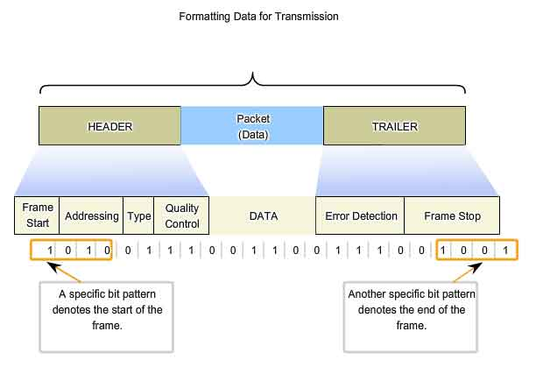
Data Link Layer Layer 2 Frame Structure
Notes:
Section 4.3.2.1

Slide 42
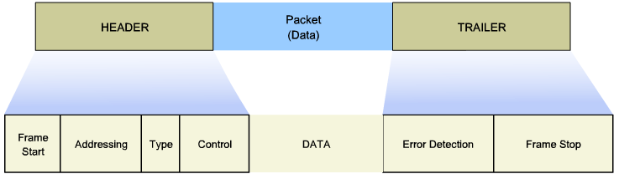
Layer 2 Frame Structure Creating a Frame
Notes:
Section 4.3.2.2

Slide 43
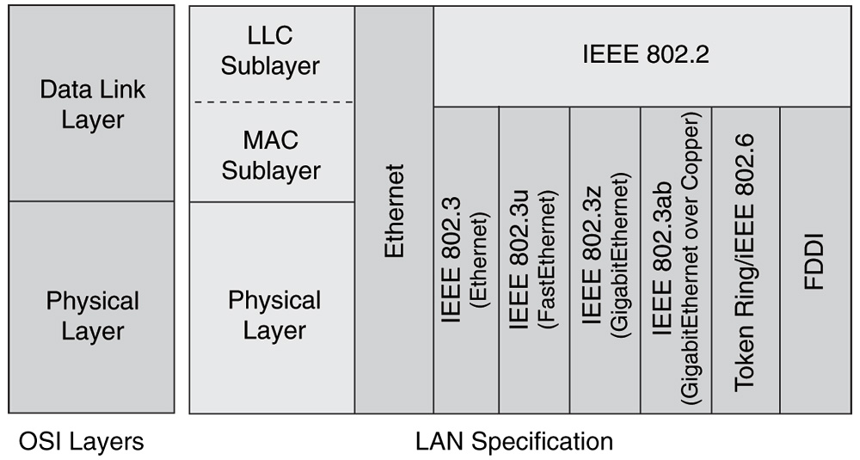
Data Link Layer Layer 2 Standards
Notes:
Section 4.3.3

Slide 44
Layer 2 Standards Data Link Layer Standards
Standard organization | Networking Standards
IEEE | 802.2: Logical Link Control (LLC) 802.3: Ethernet 802.4: Token bus 802.5: Token passing 802.11: Wireless LAN (WLAN) & Mesh (Wi-Fi certification) 802.15: Bluetooth 802.16: WiMax
ITU-T | G.992: ADSL G.8100 - G.8199: MPLS over Transport aspects Q.921: ISDN Q.922: Frame Relay
ISO | HDLC (High Level Data Link Control) ISO 9314: FDDI Media Access Control (MAC)
ANSI | X3T9.5 and X3T12: Fiber Distributed Data Interface (FDDI)
Notes:
Section 4.3.3.1

Slide 45
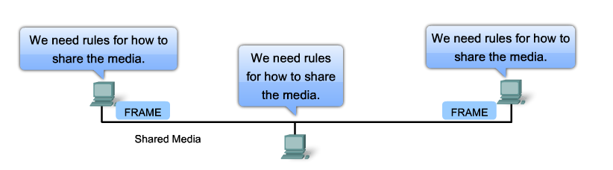
Topologies Controlling Access to the Media
Notes:
Section 4.4.1.1

Slide 46
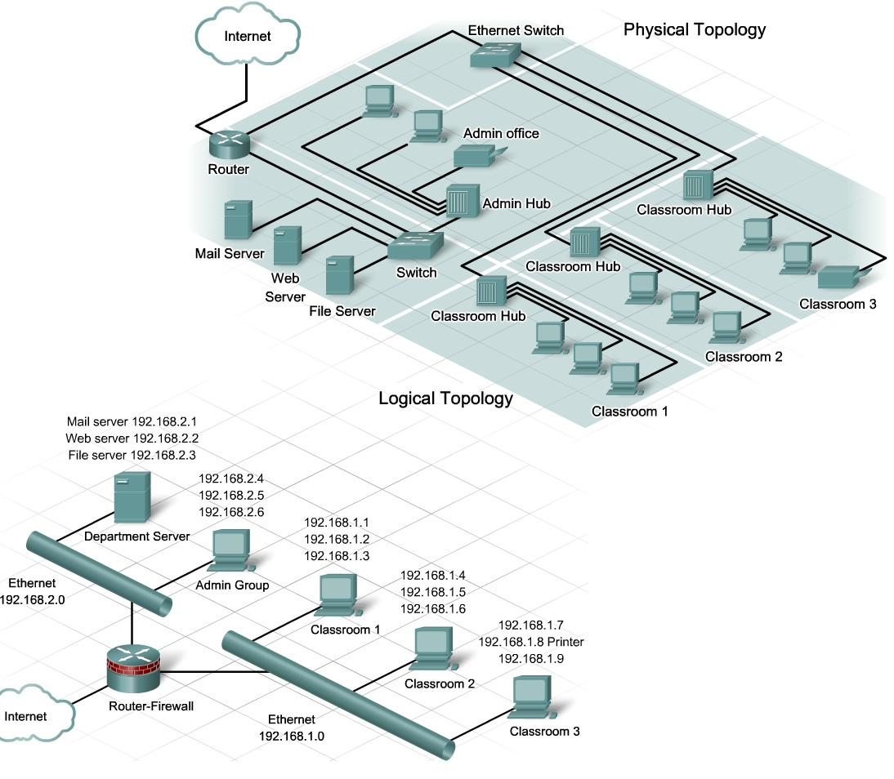
Topologies Physical and Logical Topologies
Notes:
Section 4.4.1.2

Slide 47
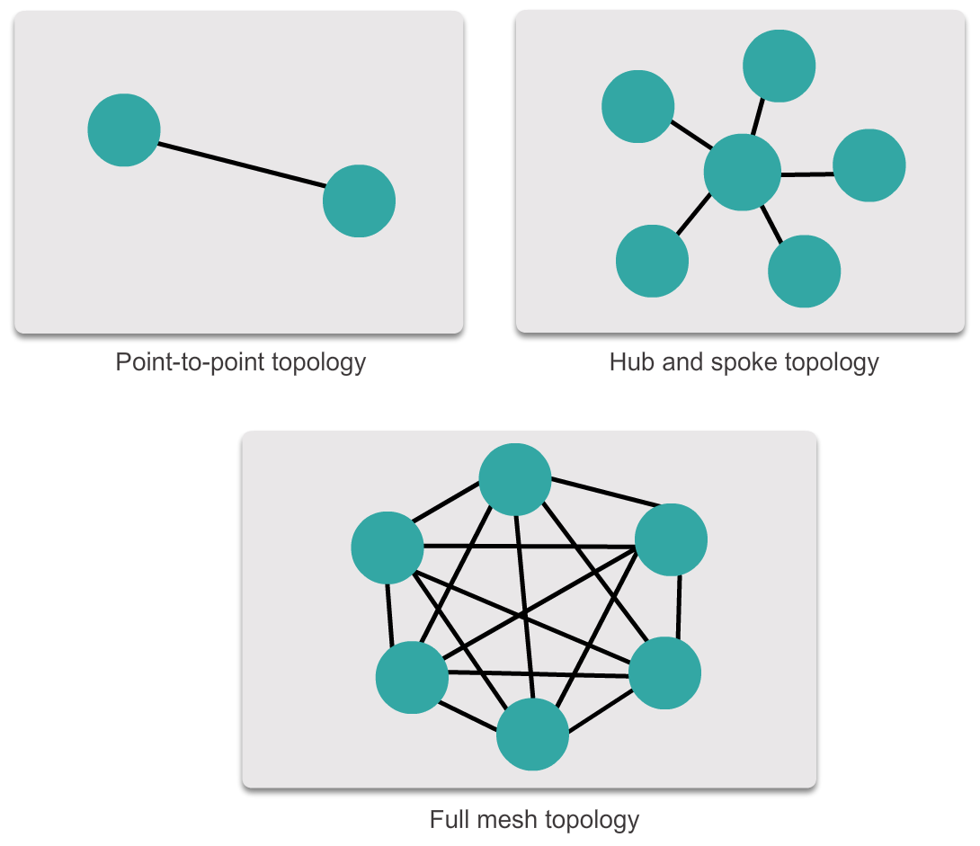
WAN Topologies Common Physical WAN Topologies
Notes:
Section 4.4.2.1

Slide 48
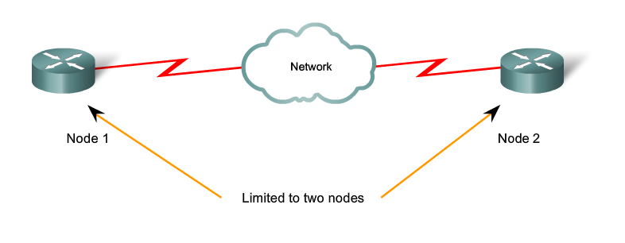
WAN Topologies Physical Point-to-Point Topology
Notes:
Section 4.4.2.2

Slide 49
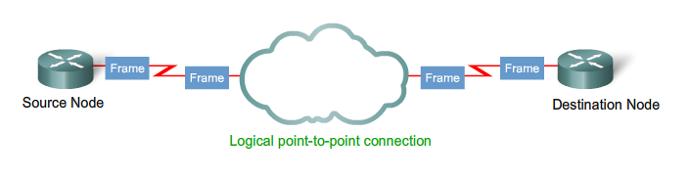
WAN Topologies Logical Point-to-Point Topology
Notes:
Section 4.4.2.3

Slide 50
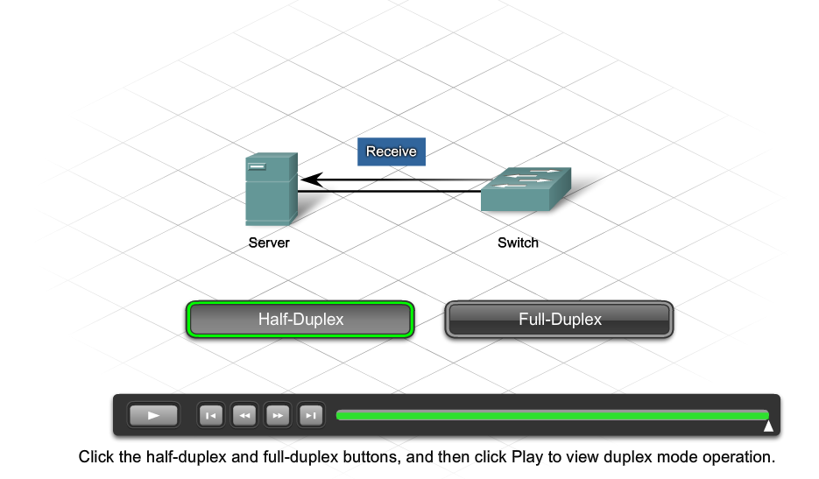
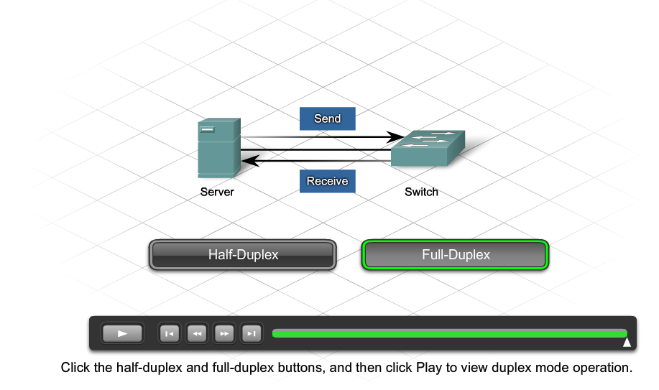
WAN Topologies Half and Full Duplex
Notes:
Section 4.4.2.4

Slide 51
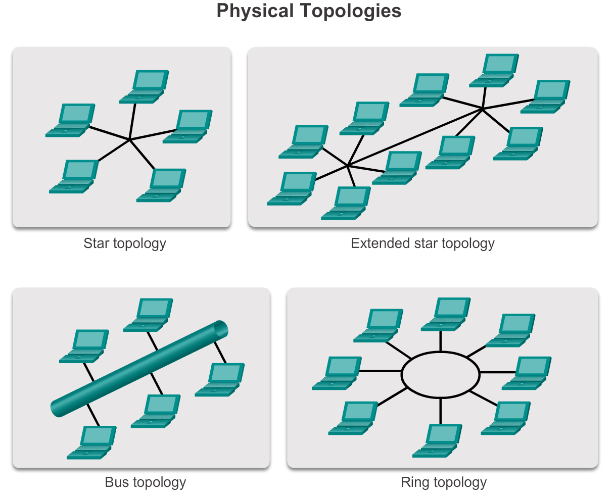
LAN Topologies Physical LAN Topologies
Notes:
Section 4.4.3.1

Slide 52
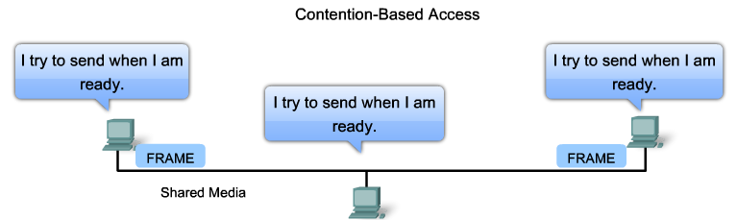
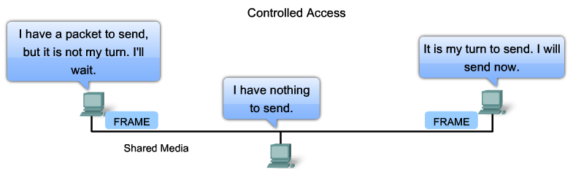
LAN Topologies Logical Topology for Shared Media
Notes:
Section 4.4.3.2

Slide 53
LAN Topologies Contention-Based Access
Characteristics | Contention-Based Technologies
Stations can transmit at any time Collision exist There are mechanisms to resolve contention for the media | CSMA/CD for 802.3 Ethernet networks CSMA/CA for 802.11 wireless networks
Notes:
Section 4.4.3.3

Slide 54
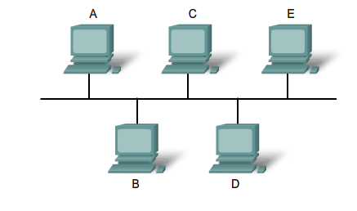
LAN Topologies Multi-Access Topology
Notes:
Section 4.4.3.4

Slide 55
LAN Topologies Controlled Access
Characteristics | Controlled Access Technologies
Only one station can transmit at a time Devices wishing to transmit must wait their turn No collisions May use a token passing method | Token Ring (IEEE 802.5) Fiber Distributed Data Interface (FDDI)
Notes:
Section 4.4.3.5

Slide 56
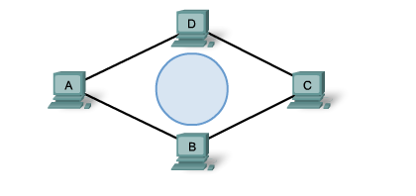
LAN Topologies Ring Topology
Notes:
Section 4.4.3.6

Slide 57
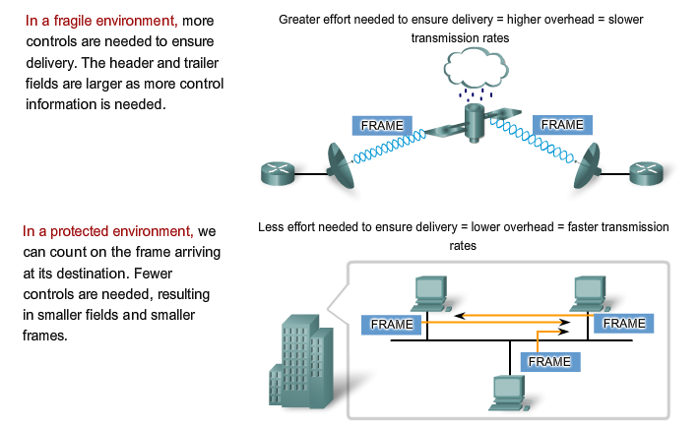
Data Link Frame The Frame
Notes:
Section 4.4.4.1

Slide 58
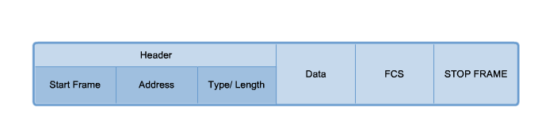
Data Link Frame The Header
Notes:
Section 4.4.4.2

Slide 59
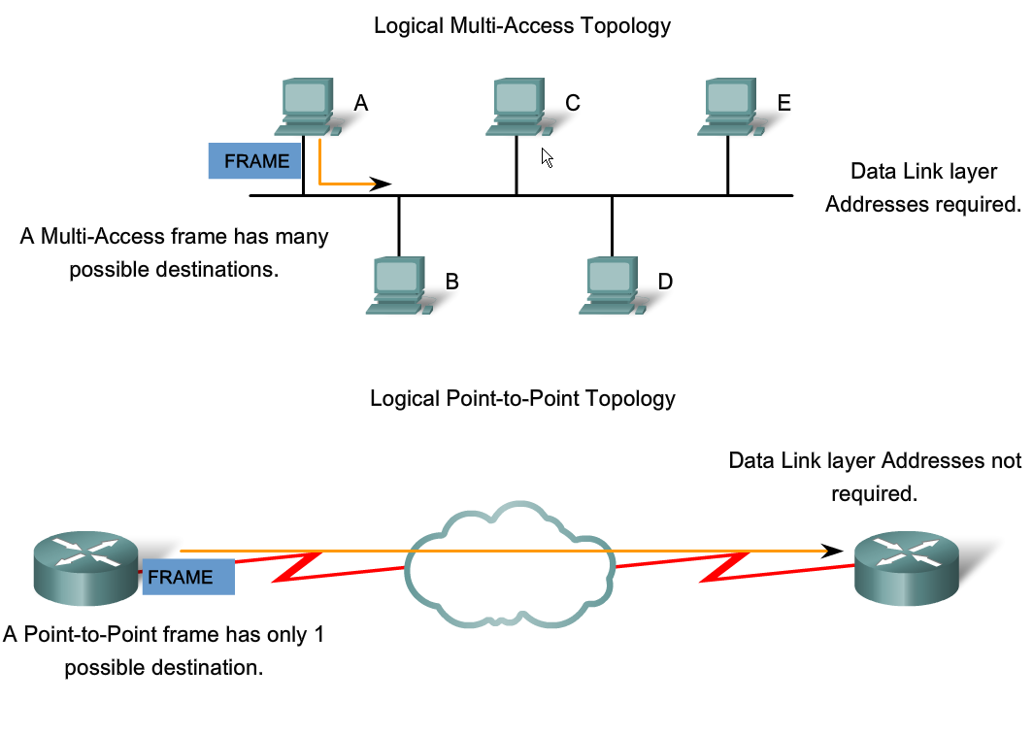
Data Link Frame Layer 2 Address
Notes:
Section 4.4.4.3

Slide 60

Data Link Frame The Trailer
Notes:
Section 4.4.4.4

Slide 61

Data Link Frame LAN and WAN Frames
Notes:
Section 4.4.4.5

Slide 62

Data Link Frame Ethernet Frame
Notes:
Section 4.4.4.6

Slide 63

Data Link Frame Point-to-Point Protocol Frame
Notes:
Section 4.4.4.7

Slide 64

Data Link Frame 802.11 Wireless Frame
Notes:
Section 4.4.4.8

Slide 65
Network Access Summary
Physical Layer Protocols
Network Media
Data Link Layer Protocols
Media Access Control
Notes:
Section 4.5

Slide 66


